Slide 1
趨勢特別獎5名得主
1

Slide 2
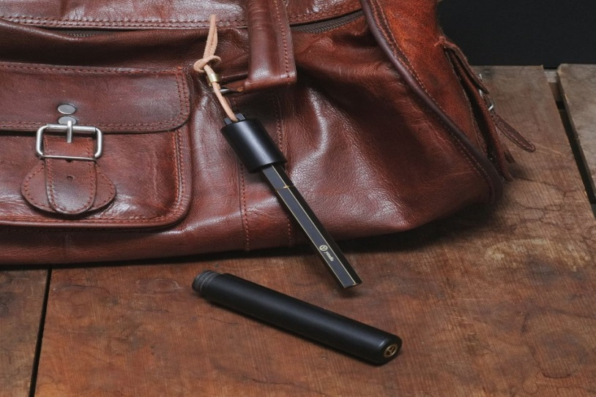
2017臺灣文博會文創精品獎 趨勢特別獎
物外有限公司 ystudio co., LTD. 攤位編號：松山S2-009
作品照片 | 作品名稱(中)：露銅系列-攜帶型鋼筆 作品名稱(英)：Brassing-Portable Fountain Pen
 | 作品介紹： 傳統鋼筆利用筆夾讓人們隨身攜帶，但現代人不一定每天都會穿著襯衫。物外透過鋼筆筆身搭配實木筆盒，結合銅環與皮繩，讓使用者率性且灑脫的搭配，越使用越可展現生活風格。 The brassing on the metal surface was accumulated through time. With the brassing, we can trace back the process that the user applied on the object and learn about their personal memory and story.Also, you can create a personalized brassing effect by removing the paint on the surface with individual preference. This process provides a unique experience to have a creative and original product that you have never had before.
文創精品獎Cultural & Creative Award

Slide 3
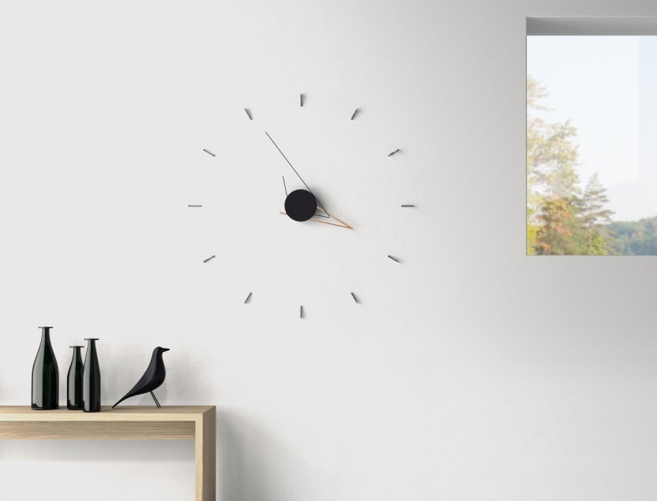
2017臺灣文博會文創精品獎 趨勢特別獎
谿品設計有限公司 PHI LTD 攤位編號：松山S1-031
作品照片 | 作品名稱(中)：剪影鐘 作品名稱(英)：Silo Clock
 | 作品介紹： 如同時間本身每分每秒的獨一無二，每回你抬起頭望向剪影鐘都會看到一個全然不同的圖像剪影。提供精準的報時機能且成為室內空間中的視覺亮點。 Silo is a simplistic sculptural clock designed to create interesting aesthetic appeal through the use of angular hour and minute hands that play on mathematical tangential relations and triangular forms. This clock is a perfect art piece of your home through its ability to cast attractive shadows on the wall whilst creating a different sculptural art-piece every time you stare at it.
文創精品獎Cultural & Creative Award

Slide 4
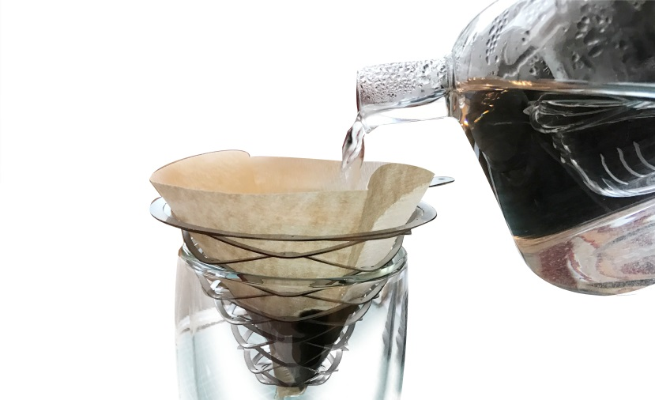
2017臺灣文博會文創精品獎 趨勢特別獎
品研生活美學有限公司 pinyen creative Inc. 攤位編號：松山S1-033
作品照片 | 作品名稱(中)：咖啡漏 作品名稱(英)：Coffee dripper
 | 作品介紹： 香濃咖啡香佐一份靜謐的金屬冷調，在咖啡因的催化下昇華。萃取出金屬編織的傳統美感及意象，運用現代科技以及科技材料，製作出具現代用途、卻有美感傳承的咖啡漏。 Coordinate with the cold tone of metals, the aromatic coffee sublimates under the catalysis of caffeine. Inspired by the craft of tradition Manual weaving, and combine with new-tech produce processing and special stainless steel which known as the material of spring. Showing a useful and traditional beauty coffee dripper. It’s easy to bring out and with a filter paper, providing you with aromatic and mellow coffee.
文創精品獎Cultural & Creative Award

Slide 5
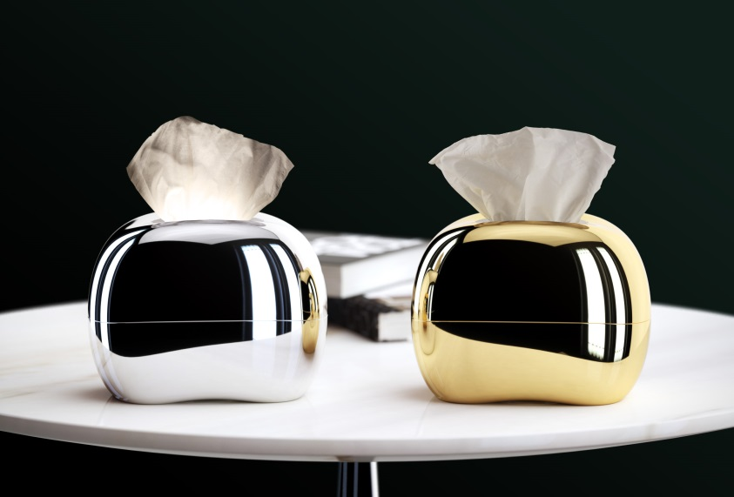
2017臺灣文博會文創精品獎 趨勢特別獎
九磨設計有限公司 mordéco 攤位編號：松山S5-023
作品照片 | 作品名稱(中)：MIRRO 面紙盒 作品名稱(英)：MIRRO tissue box
 | 作品介紹： 無稜角的造型融洽搭配各種空間風格，金屬質感鏡面外觀除了成為空間亮點，輕輕一觸，柔軟面紙緩緩成為空間的氛圍燈，每次使用燈具就改變形狀。 生活不就是一種隨機的創作嗎！ It fits anywhere, anytime and any kind of tissue in the most simple way. Equipped with its own spotlight, with just one touch from any angle, it brings light into your life. Surfaced with premium sleek metal, extremely durable, scratch ressistance and with perfect reflection
文創精品獎Cultural & Creative Award

Slide 6
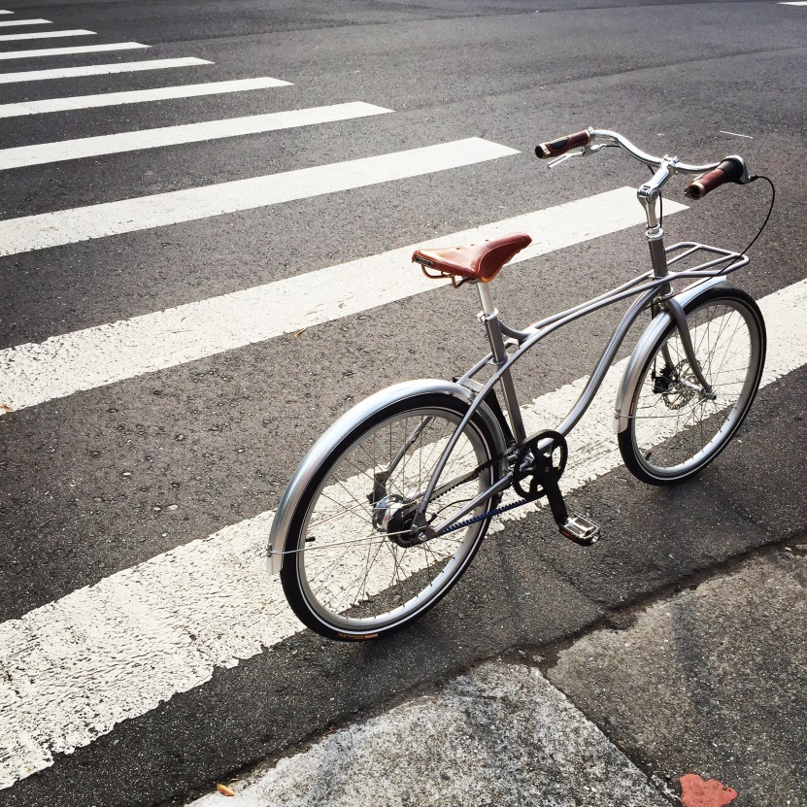
2017臺灣文博會文創精品獎 趨勢特別獎
俏可設計有限公司 Ciao Design Studio LLC 攤位編號：松山S5-005
作品照片 | 作品名稱(中)：MiniYEE Premium 作品名稱(英)：MiniYEE Premium
 | 作品介紹： 「YEE」系列的小輪徑頂級車款，專為亞洲人身型嬌小所設計24吋，手工拋光鉻鉬鋼車架展現鋼管原始質感，搭配世界最強韌Gates碳纖皮帶傳動系統與Shimano內變七速，座墊採用英國Brooks手工座墊。 The 24" Mini Velo top of the line version of the "YEE" lineup. Designed specially for the smaller Asian riders. The hand polished cromoly frame exposes its natural metallic shine and quality. Equipped with the world strongest carbon belt-drive system by Gates and Shimano inter-7 speed. Paired with the hand crafted "Brooks" saddle. The overall look provides the premium urban cycling experience with personal style and taste.
文創精品獎Cultural & Creative Award

Slide 7
文創精品獎30名得主
7

Slide 8
2017臺灣文博會文創精品獎
物外有限公司 ystudio co., LTD. 攤位編號：松山S2-009
作品照片 | 作品名稱(中)：露銅系列-攜帶型鋼筆 作品名稱(英)：Brassing-Portable Fountain Pen
 | 作品介紹： 傳統鋼筆利用筆夾讓人們隨身攜帶，但現代人不一定每天都會穿著襯衫。物外透過鋼筆筆身搭配實木筆盒，結合銅環與皮繩，讓使用者率性且灑脫的搭配，越使用越可展現生活風格。 The brassing on the metal surface was accumulated through time. With the brassing, we can trace back the process that the user applied on the object and learn about their personal memory and story.Also, you can create a personalized brassing effect by removing the paint on the surface with individual preference. This process provides a unique experience to have a creative and original product that you have never had before.
文創精品獎Cultural & Creative Award

Slide 9
2017臺灣文博會文創精品獎
谿品設計有限公司 PHI LTD 攤位編號：松山S1-031
作品照片 | 作品名稱(中)：剪影鐘 作品名稱(英)：Silo Clock
 | 作品介紹： 如同時間本身每分每秒的獨一無二，每回你抬起頭望向剪影鐘都會看到一個全然不同的圖像剪影。提供精準的報時機能且成為室內空間中的視覺亮點。 Silo is a simplistic sculptural clock designed to create interesting aesthetic appeal through the use of angular hour and minute hands that play on mathematical tangential relations and triangular forms. This clock is a perfect art piece of your home through its ability to cast attractive shadows on the wall whilst creating a different sculptural art-piece every time you stare at it.
文創精品獎Cultural & Creative Award

Slide 10
2017臺灣文博會文創精品獎
品研生活美學有限公司 pinyen creative Inc. 攤位編號：松山S1-033
作品照片 | 作品名稱(中)：咖啡漏 作品名稱(英)：Coffee dripper
 | 作品介紹： 香濃咖啡香佐一份靜謐的金屬冷調，在咖啡因的催化下昇華。萃取出金屬編織的傳統美感及意象，運用現代科技以及科技材料，製作出具現代用途、卻有美感傳承的咖啡漏。 Coordinate with the cold tone of metals, the aromatic coffee sublimates under the catalysis of caffeine. Inspired by the craft of tradition Manual weaving, and combine with new-tech produce processing and special stainless steel which known as the material of spring. Showing a useful and traditional beauty coffee dripper. It’s easy to bring out and with a filter paper, providing you with aromatic and mellow coffee.
文創精品獎Cultural & Creative Award

Slide 11
2017臺灣文博會文創精品獎
九磨設計有限公司 mordéco 攤位編號：松山S5-023
作品照片 | 作品名稱(中)：MIRRO 面紙盒 作品名稱(英)：MIRRO tissue box
 | 作品介紹： 無稜角的造型融洽搭配各種空間風格，金屬質感鏡面外觀除了成為空間亮點，輕輕一觸，柔軟面紙緩緩成為空間的氛圍燈，每次使用燈具就改變形狀。 生活不就是一種隨機的創作嗎！ It fits anywhere, anytime and any kind of tissue in the most simple way. Equipped with its own spotlight, with just one touch from any angle, it brings light into your life. Surfaced with premium sleek metal, extremely durable, scratch ressistance and with perfect reflection
文創精品獎Cultural & Creative Award

Slide 12
2017臺灣文博會文創精品獎
俏可設計有限公司 Ciao Design Studio LLC 攤位編號：松山S5-005
作品照片 | 作品名稱(中)：MiniYEE Premium 作品名稱(英)：MiniYEE Premium
 | 作品介紹： 「YEE」系列的小輪徑頂級車款，專為亞洲人身型嬌小所設計24吋，手工拋光鉻鉬鋼車架展現鋼管原始質感，搭配世界最強韌Gates碳纖皮帶傳動系統與Shimano內變七速，座墊採用英國Brooks手工座墊。 The 24" Mini Velo top of the line version of the "YEE" lineup. Designed specially for the smaller Asian riders. The hand polished cromoly frame exposes its natural metallic shine and quality. Equipped with the world strongest carbon belt-drive system by Gates and Shimano inter-7 speed. Paired with the hand crafted "Brooks" saddle. The overall look provides the premium urban cycling experience with personal style and taste.
文創精品獎Cultural & Creative Award

Slide 13
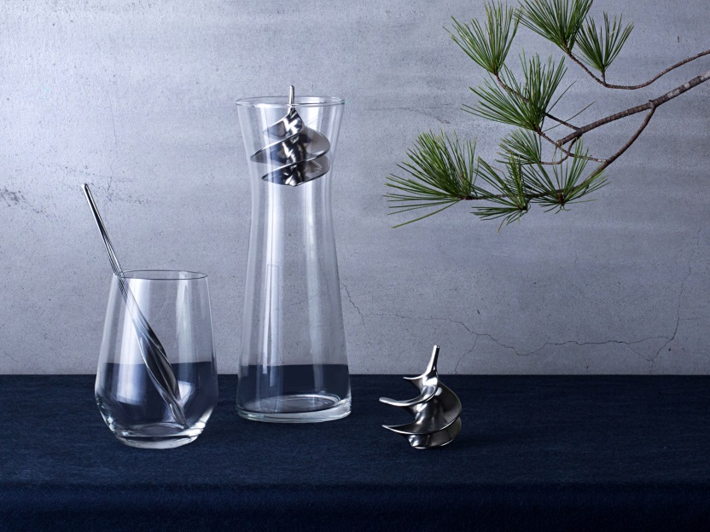
2017臺灣文博會文創精品獎
曲率實驗工作室 Curvature Lab攤位編號：松山S1-021
作品照片 | 作品名稱：浪雲醇酒器 Liquor Perfection
 | 作品介紹： 純錫製成的浪雲醇酒器，可以和緩嗆辣感，使酒香釋放，口感更濃厚圓滑，適用各類酒款。相比市售醒酒器，浪雲醇酒器另有淨化水質，使酒和茶水都更為甘甜的效果。 Tin can remove the bitterness from alcoholic beverages. With the spiral/blade shape representing an imagery of flowing water, the tin decanters increase the contact surface with the alcoholic beverages. They fit in all kinds of glasses or the decanting system. The liquor forms beautiful stream while flowing through the spiral and becomes mellow in a very short time.
文創精品獎Cultural & Creative Award

Slide 14
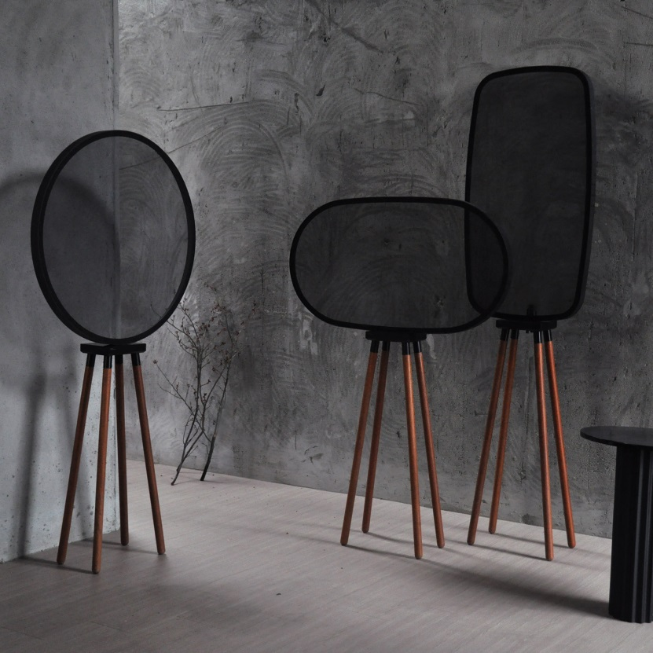
2017臺灣文博會文創精品獎
黑生起司 HEY SHENG CHI SI 攤位編號：華山H1-36
作品照片 | 作品名稱(中)：交織 情境燈組 作品名稱(英)：INTERLACED
 | 作品介紹： 靈感來自透過木窗看窗外月亮，模糊又清楚的感覺，利用金屬網營造交織光影效果，將視覺作切割，透過構成疏密排列，室內能透過 INTERLACED 感受光的微妙相互作用，也能當作情境裝飾。 Seeing the moon from a wood window, used wire mesh to re-create this blurred image of the moon. This work can be used as a lighting device or simply a decoration. “INTERLACED” can also be used as a decorative screen to divide the vision with an effect of mixed layers. With various arrangements, “INTERLACED” can create an atmosphere for its users to experience the magic of the light.
文創精品獎Cultural & Creative Award

Slide 15
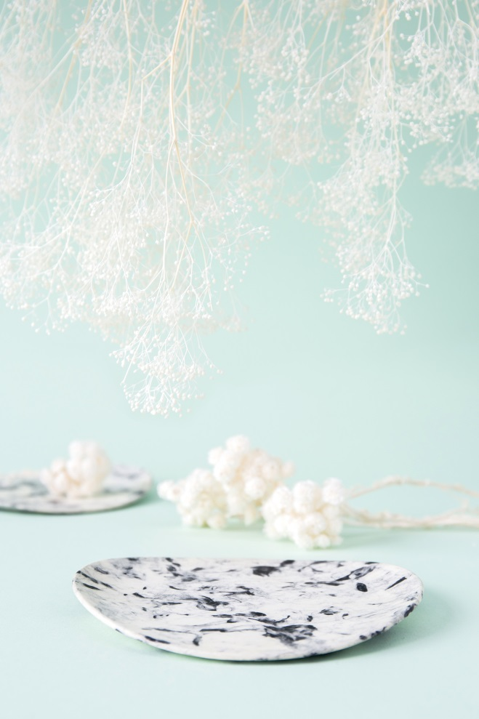
2017臺灣文博會文創精品獎
濯濁有限公司 Studio Lim 攤位號碼：華山H1-18
作品照片 | 作品名稱(中)：纖維木器-點心盤 作品名稱(英)：Fibrewood Objects-Dessert Plate
 | 作品介紹： 纖維木器是天然纖維製成，環保永續。它有著纖維的溫暖以及可塑性，使用近似於漆器的多道手工上漆研磨，質輕不易破損。製程中形成的花紋讓每一片都有著獨一無二的樣貌。 Fibrewood Objects manifests the use of innovative environmental material with a sense of aesthetic uniqueness. Being through retrospective experiments for over few hundred times in two years, Fibrewood is a sustainable material made of natural fibre, such as flax. Studio Lim also collaborates with local carpenters in Taiwan and put scrap wood to good use. Using similar technique like making lacquerware with a touch of human hand, the dessert plates perfectly bring together modern manufacturing techniques with craft, resulting in an ever-changing pattern which is the central feature of each unique product. 5 individual styles or set of 2 available.
文創精品獎Cultural & Creative Award

Slide 16
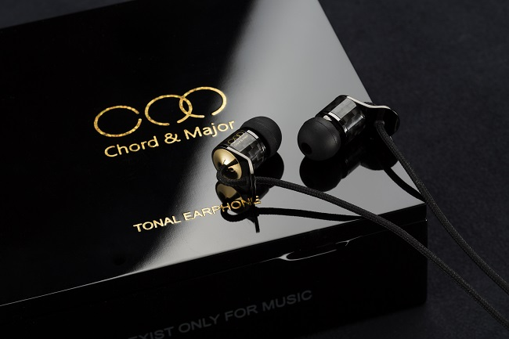
2017臺灣文博會文創精品獎
悅聲志業股份有限公司 C & M AUDIO CO., LTD 攤位編號：松山S5-028
作品照片 | 作品名稱(中)：Major 01'16 電子音樂調性耳機 作品名稱(英)：Major 01'16 Electronic Music Tonal Earphone
 | 作品介紹： Major 01’16 有5~40kHz以上的極致頻寬，反應出電子音樂極端的細節變化，重低音深沉有力、突顯顆粒感，中高音俐落分明、反應速度佳，充份彰顯多元精彩的編曲變化與音樂性! Generalized “Electronic Music” is synthesized music produced using electronic equipment, computer software and other electronic technology. It also contains some traditional acoustic elements, when combined with technology create an electroacoustic juxtaposition. Through advancements in music technology the capability to alter sound has become far-reaching, resulting in an escape from traditional sounding instruments and music logic, into the endlessly creative realm of “Electronica”. The Major 01’16 has a full bass response, highlights different textures, and has a crystal clear mid-range. It is sensitive and dynamic, fully expressing the genius behind different types of electronic music.
文創精品獎Cultural & Creative Award

Slide 17
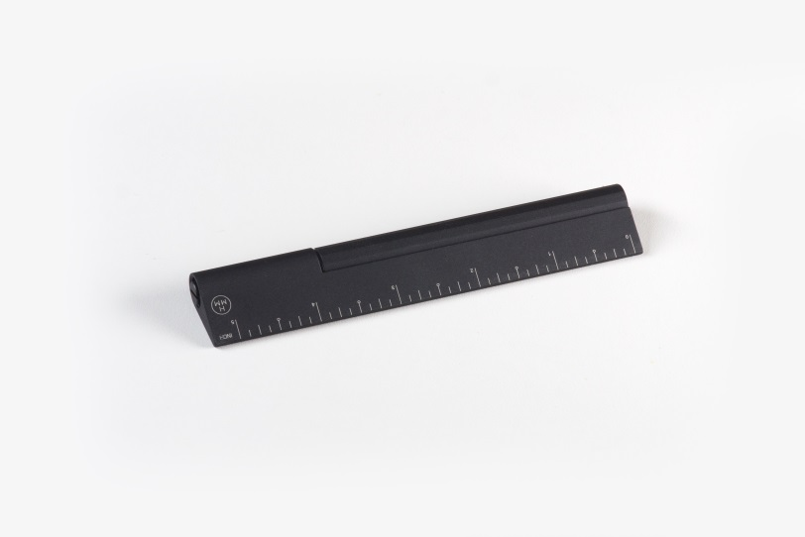
2017臺灣文博會文創精品獎
奇意果國際有限公司 Kiwico Corporation 攤位編號：松山S7-002
作品照片 | 作品名稱(中)：Rule/One 尺筆 作品名稱(英)：Rule/One
 | 作品介紹： 2014 Kickstarter 募資成功，2015 紅點設計榮譽獎肯定。重新思考書寫者與文具間的互動，以精密計算的細節打造更為俐落流暢的使用經驗。 As designers, we relish how actions of drafting and where they take place interact. This pen-ruler combination perfectly fits your notebook as a bookmark with its unique droplet shape while fulfilling different uses - on paper, on tablet, and on the go - with the interchangeable heads. Sleek, compact, this finely crafted tool is light and delightful to unleash your ideas with joy. Funded on Kickstarter in 2014. Honored with Red Dot Award 2015.
文創精品獎Cultural & Creative Award

Slide 18
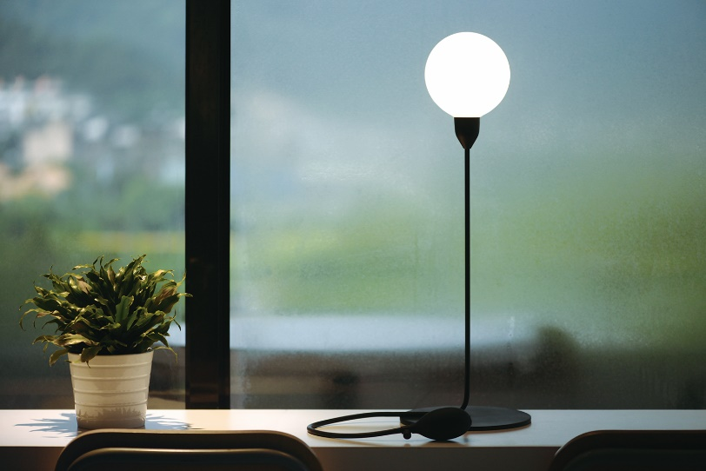
2017臺灣文博會文創精品獎
華惟國際有限公司 PEGA INTERNATIONAL LIMITED 攤位編號：松山S5-020
作品照片 | 作品名稱(中)：充氣式桌燈 作品名稱(英)：Pumplight
 | 作品介紹： Pumplight 是一座藉由按壓充氣來點亮的桌燈，隨著氣球膨脹的大小，你會發現燈光也跟著漸漸明亮起來，有別於傳統桌燈開關明滅的直白。 “Pumplight”, an interactive design encourages you to pump it to shine the bulb ; turning physical energy to brightness, the most measurable method in exchange for light. Keep pumping, and enjoy the nuances of the light; Fly your dream with the balloon!!
文創精品獎Cultural & Creative Award

Slide 19
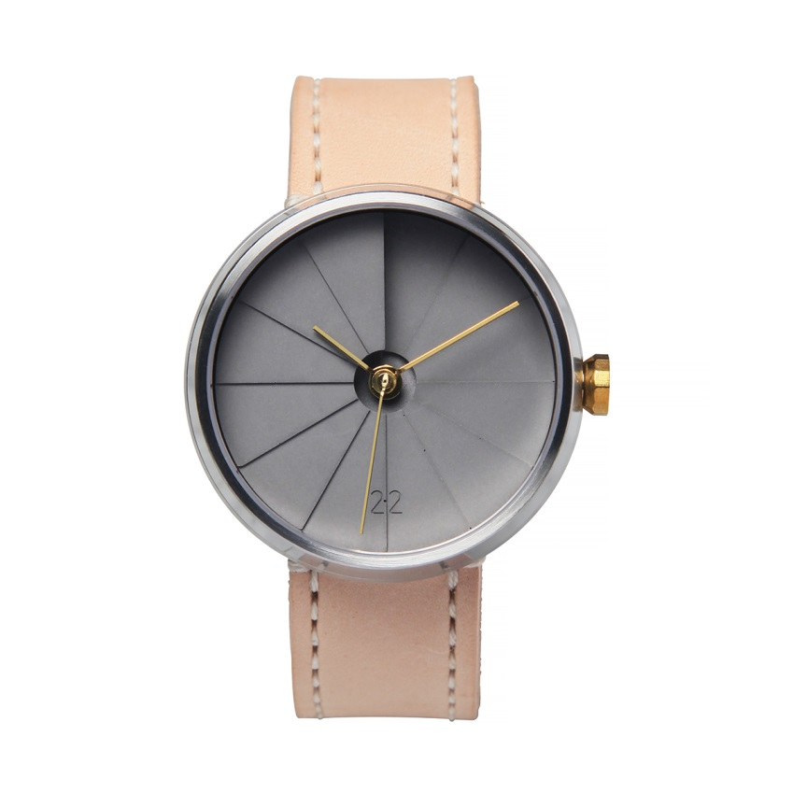
2017臺灣文博會文創精品獎
二十二設計有限公司 22 Design Studio Co., Ltd. 攤位編號：松山S4-031
作品照片 | 作品名稱(中)：四度空間腕錶 42mm 經典款 作品名稱(英)：4th Dimension Watch 42mm Original Edition
 | 作品介紹： 水泥錶面、髮絲紋316L不鏽鋼錶殼、黃銅指針、黃銅錶冠與義大利原皮錶帶。細節中呈現材質最原始的質感。隨著佩戴者的使用習慣，指針、錶冠逐漸氧化，展現獨一無二的風情。 The Original Model combines the authentic concrete base as the watch surface with a brushed stainless steel bezel, untreated brass hands and crown, and a naturally tanned leather band. Every detail of the wristwatch highlights the original beauty of the materials and is a natural fit for the casual wearer.
文創精品獎Cultural & Creative Award

Slide 20
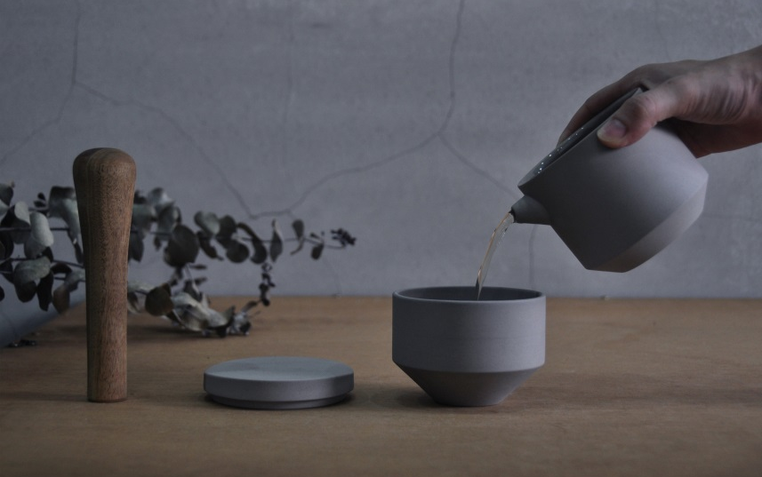
2017臺灣文博會文創精品獎
黑生起司 HEY SHENG CHI SI 攤位編號：華山H1-36
作品照片 | 作品名稱(中)：擂茶搗組 作品名稱(英)：LEI CHA
 | 作品介紹： 陶瓷製成，搭配具手感且優美的木棒，去研磨或混合各種粗糙的藥草和香料，是便於自行混合的當代料理工具。 Made from ceramics, ease of use and finished with a beautifully shaped wood handle for grinding and mixing various rough herbs and spices. Easily make your own spice mixes and this will make a great looking, useful tool to anyone.
文創精品獎Cultural & Creative Award

Slide 21
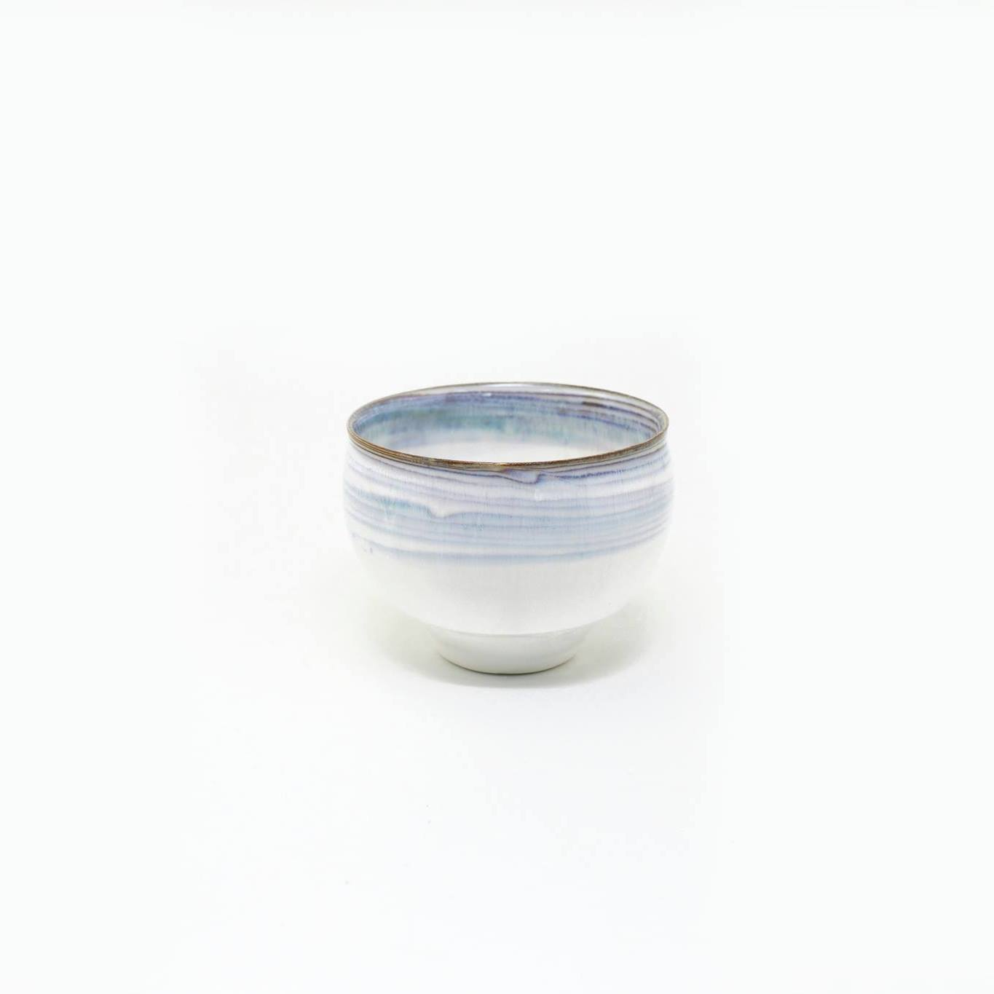
2017臺灣文博會文創精品獎
大器創意有限公司 DAQI CONCEPT Ltd. 攤位編號：松山S1-003
作品照片 | 作品名稱(中)：夏綠蒂 茶碗 作品名稱(英)：Charlotte / Tea Bowl
 | 作品介紹： 素雅的線條搭配高溫釉藥燒製，闡述生活中緩慢而寧靜的哲學。 Simple and Elegant form, high temperature glazes. About Ceramics, daily Life, and inner peace.
文創精品獎Cultural & Creative Award

Slide 22
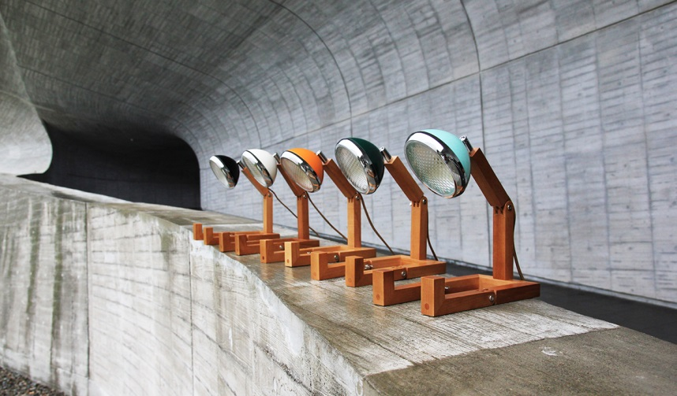
2017臺灣文博會文創精品獎
隆翊工業股份有限公司 Long Yi Hardware Industry Corp 攤位編號：松山S7-004
作品照片 | 作品名稱(中)：LED梣木機器人燈 作品名稱(英)：LED Ash wood robot lamp
 | 作品介紹： 機器人燈選用了鋁合金和梣木材質作為創作元素,燈罩烤漆採用粉體烤漆200°C高溫硬化處理,具飽合及耐久性,燈罩部分可以120°左右調整,彷彿人般的關節是特色之一。 The parts are made of high grade alloy and ash wood making it distinctive and tasteful and the coating can stand a heat up to 200°C，and the lamp shade is adjustable with 120° like a robotic figurine。
文創精品獎Cultural & Creative Award

Slide 23
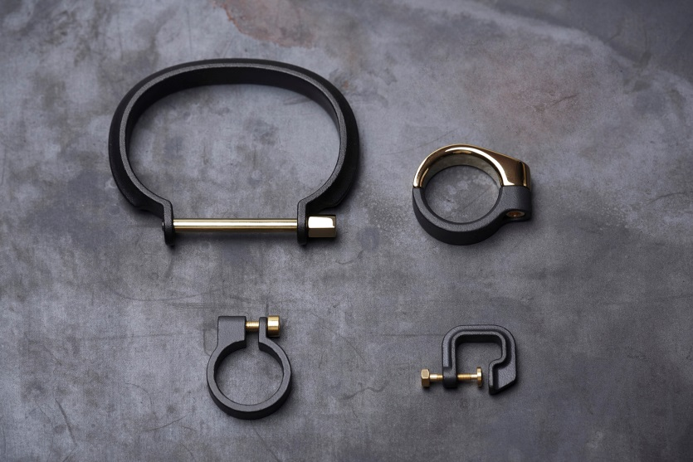
2017臺灣文博會文創精品獎
鑽岩設計有限公司 Drilling lab 攤位編號：松山S7-006
作品照片 | 作品名稱(中)：夾.鎖 系列 作品名稱(英)：Clamp series
 | 作品介紹： Clamp series 貫徹純機能的思維模式，以直覺的邏輯應用將配件與身體結合，提取各式工業夾具的概念，在腕、耳骨、指節等部位合理的找到各自的角色，透過設計轉化，精準定位。 The clamp has been widely used in industrial areas, fixing parts in the correct position which increases stability and fluency in production, as an important assistive item for insuring fast and secure process. Drilling Lab implements the concept of pure function, combining the accessories to the body intuitively. Based on various industrial clamps, such as C­-clamps and cylindrical clips, Drilling Lab positions them to your wrist, ear bone, and knuckle through design.
文創精品獎Cultural & Creative Award

Slide 24
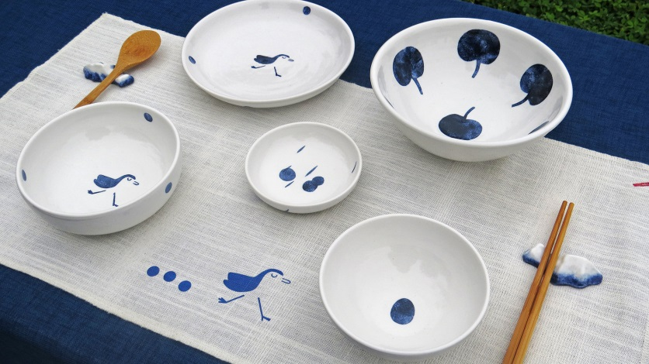
2017臺灣文博會文創精品獎
宜蘭縣政府文化局 Cultural Affairs Bureau,Yilan Vounty 攤位編號：華山H2-06
作品照片 | 作品名稱(中)：宜蘭的餐桌 作品名稱(英)：Yilan's table
 | 作品介紹： 在日本常作為清酒杯和茶杯使用，也可作為蕎麥麵食用盛裝，或是茶碗蒸食器使用；由於握在掌心的尺寸恰恰好，於是盛咖啡、酒、湯、小菜和點心…自在的融入日常。 Samsung Four Seasons Yilan Tableware Group, combined with the unique style of the culture of blue and white totem design combined with a unique classic blue and white porcelain craft production, Yilan tableware combination, so that you in the daily life of the table, can enjoy the beauty of Ilan four seasons.
文創精品獎Cultural & Creative Award

Slide 25
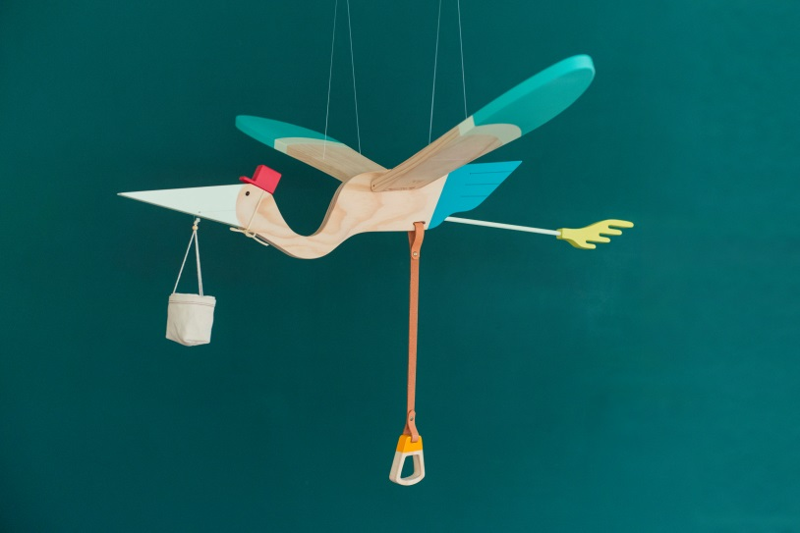
2017臺灣文博會文創精品獎
江口股份有限公司 eguchi toys 攤位號碼：松山S3-015
作品照片 | 作品名稱(中)：送子鳥 作品名稱(英)：Mobile Bird - Pelican
 | 作品介紹： 孩子喜歡徜徉在大自然中 感受光線 微風 和 雨水 我們想讓孩子生活在這樣的環境裡 將自然氛圍引入居家 輕拉木環… 飛鳥翩然… The moving mobile is good for baby who enjoys the natural feeling, to feel the light, wind and rain. Mobile bird takes the natural into our living home.
文創精品獎Cultural & Creative Award

Slide 26
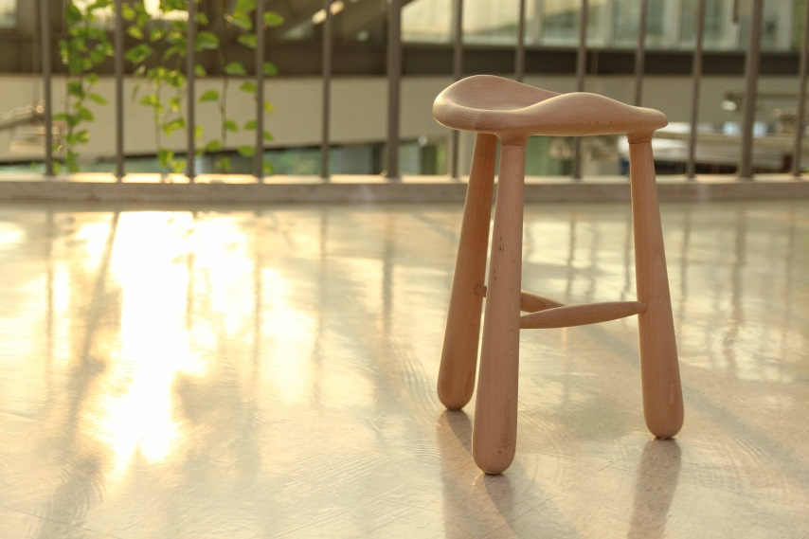
2017臺灣文博會文創精品獎
穆德設計團隊有限公司 MOTOR Design Group Ltd. 攤位編號：松山S3-015
作品照片 | 作品名稱(中)：氣泡椅 作品名稱(英)：Bubble Stool
 | 作品介紹： [氣泡椅] 以實木製造台灣五軸加工，融合北歐工藝，以台灣老師傅與設計師合作推出，全程在台灣設計 台灣製造，試著有氣泡般的舒適感，與木質的紋理，全實木，白山毛櫸材質。 [Bubble Stool] Made in Taiwan with 5-axis machining and integration of the Nordic craftwork, the Taiwanese master and designer collaborate to create a full-scale design in Taiwan. Trying to have bubble-like comfort with wood texture, White beech material.
文創精品獎Cultural & Creative Award

Slide 27
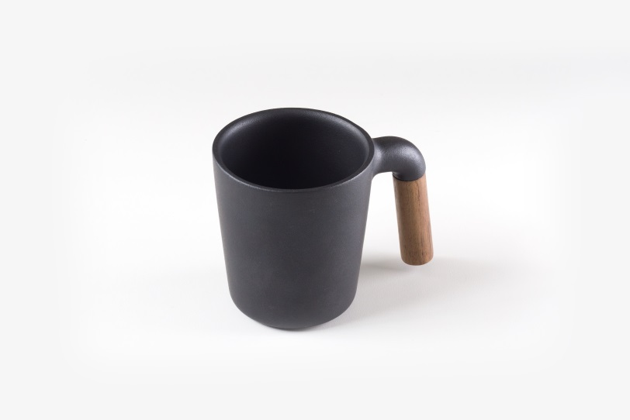
2017臺灣文博會文創精品獎
奇意果國際有限公司 Kiwico Corporation 攤位編號：松山S7-002
作品照片 | 作品名稱(中)：Mugr 木柄馬克杯 作品名稱(英)：Mugr
 | 作品介紹： 由數十年經驗工匠手工塑造、鑄鐵般沈穩溫潤的霧面陶瓷，與細膩的實木木柄相映成趣，在幾輪使用後將越發光澤，漸次成為你桌上最美的風景。 Mugr is where Earth Meets Wood. Handmade by Taiwanese and Chinese artisans, this mug demonstrates the fine craftsmanship of decades’ experience. The unique matte glazed Japanese ceramic lends a look and feel of cast iron while the wood forms the signature shape to make the most beautiful landscape on your table.
文創精品獎Cultural & Creative Award

Slide 28
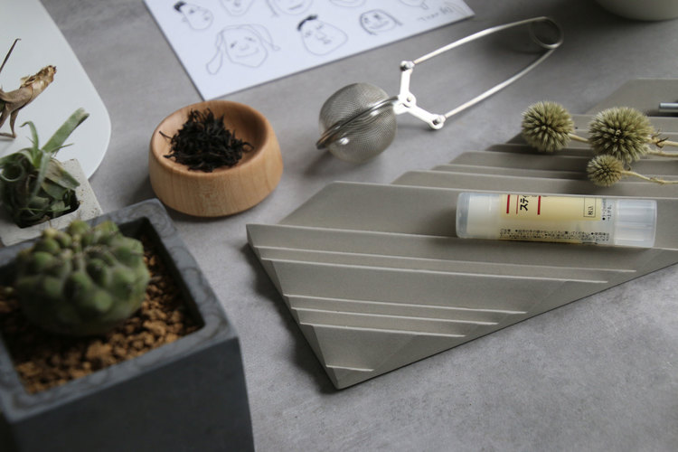
2017臺灣文博會文創精品獎
享向設計有限公司 Shiang Design Co., Ltd. 攤位號碼：松山S7-011
作品照片 | 作品名稱(中)：桌景 作品名稱(英)：Tandscape
 | 作品介紹： 以山為意象，化作為文具與首飾架，給你桌上一個最美的景緻。與台灣本地的陶瓷廠合作，每一個菱角，在在展現細緻的台灣陶瓷工藝。 “Tandscape” is a desk organizer. The forms of” Tandscape” are transformed from the beautiful image of mountains for you to create your own table landscape.
文創精品獎Cultural & Creative Award

Slide 29
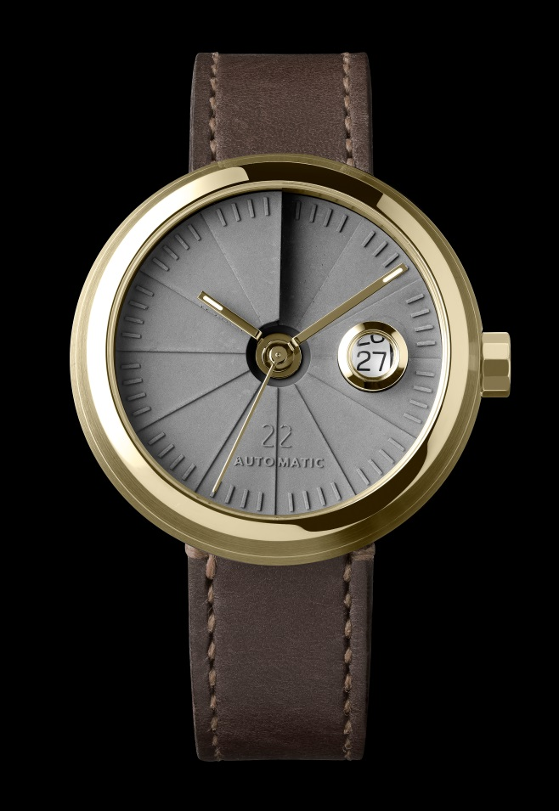
2017臺灣文博會文創精品獎
二十二設計有限公司 22 Design Studio Co., Ltd. 攤位編號：松山S4-031
作品照片 | 作品名稱(中)：四度空間機械錶 作品名稱(英)：4th Dimension Mechanical Watch
 | 作品介紹： 四度空間機械錶，看到一種毫不遮掩的生活態度，鋼是鋼、銅是銅、水泥是水泥。每個材料展現出赤裸、真實的面貌。同時藉由表面處理、零件組合的不同，展現出多樣的城市風情。 From the delicate sculpting of the concrete watch face to the hand-shaped brass hands, from the brass crown to the leather strap, every detail of our wristwatch has been designed to show the beauty of the raw material. This unique timepiece's leather and brass becomes richer and darker the more the watch is worn, personalizing it and making it ever more comfortable as time passes.
文創精品獎Cultural & Creative Award

Slide 30
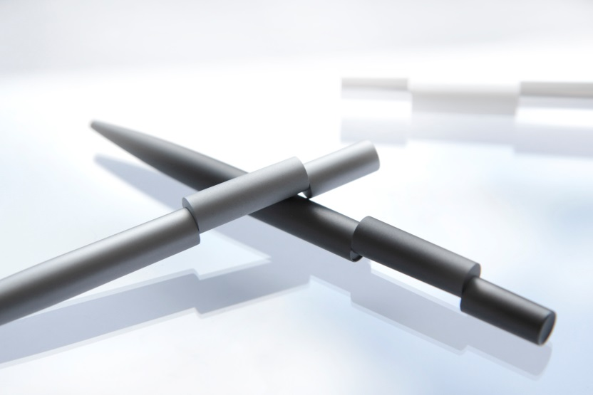
2017臺灣文博會文創精品獎
谿品設計有限公司 PHI LTD 攤位編號：松山S1-031
作品照片 | 作品名稱(中)：偏軸旋轉筆 作品名稱(英)：Align Twist Ballpoint pen
 | 作品介紹： ALIGN 偏軸書寫筆的視覺重點是一截錯位的筆身。ALIGN 洗煉以及極簡的外型、配合使用方式的巧思，讓他不同於一般僅有功能性的書寫筆，而成為一個極具概念意涵的設計精品。 Called Align, this minimal pen 's body is divided into three parts, where the middle part is dislocated when the pen is closed. To use the pen you simply need to twist the pen to align the middle part with the rest of the body, the pen tip will be pushed out following the alignment. The pen is carefully crafted in hi-grade aluminium, where the innovative off-centered twist mechanism is precisely put together inside this tiny object. It took six months of research and development to bring this complicated mechanism to life.
文創精品獎Cultural & Creative Award

Slide 31
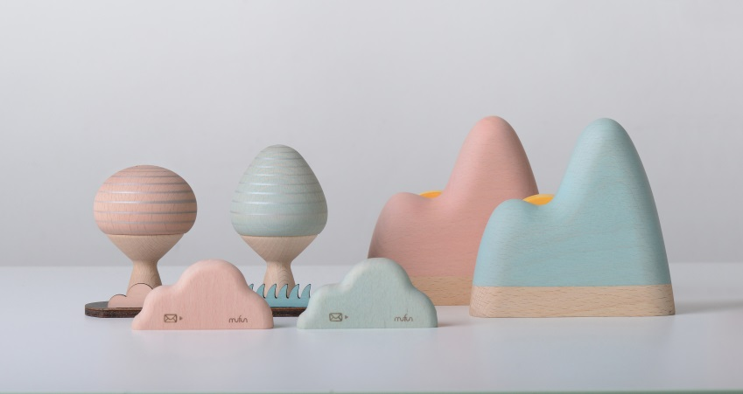
2017臺灣文博會文創精品獎
木趣設計工作室 mufun design studio 攤位編號：松山S2-022
作品照片 | 作品名稱(中)：情境物件粉彩系列文具-拆信刀&膠帶台&小物罐 作品名稱(英)：Ambience Object - Pink Series - Letter Opener & Sticky Tape & Tree-Shaped Cans
 | 作品介紹： 以棲地生態為創作靈感，將大自然的生態與景物，與日常生活常用的桌上物件相結合。靜置時可化作空間中自然、溫潤的小風景。低調融入的實用機能，為您帶來使用上的小驚喜。 Little wonderland for your desktop, where sensibility and rationality meet! The functional ambience object series invite you to wonder the natural beauty in your daily life.
文創精品獎Cultural & Creative Award

Slide 32
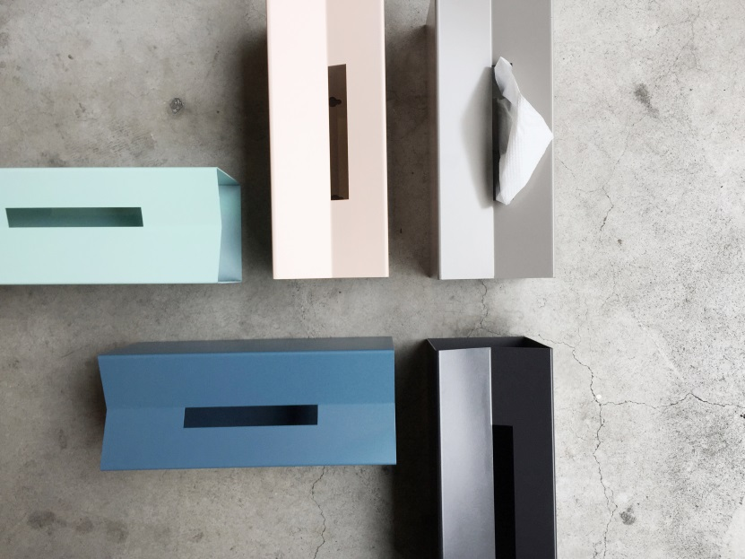
2017臺灣文博會文創精品獎
生活起物有限公司 googoods co., Ltd. 攤位編號：松山S1-006
作品照片 | 作品名稱(中)：M 面紙盒 作品名稱(英)：M tissue box
 | 作品介紹： 市售衛生紙包裝，總破壞空間氛圍。M面紙盒方便放置、更換，簡單造型又不失功能性，V型凹槽可放置小物品。 M tissue box is simple, functional, easy to use. You can put it on the table, or even mount it on the wall. The V curve allows you to put some gadgets/items on it.
文創精品獎Cultural & Creative Award

Slide 33
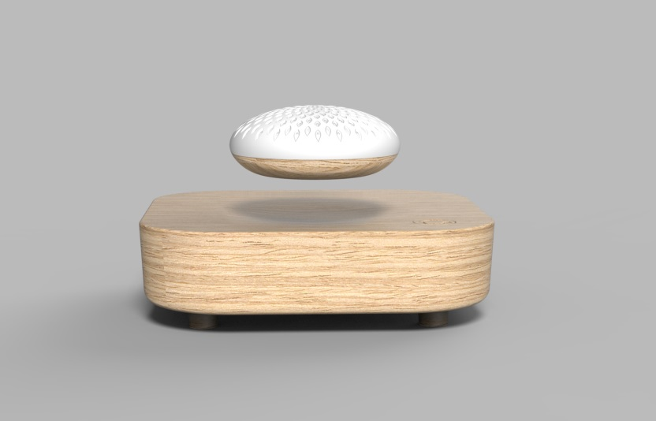
2017臺灣文博會文創精品獎
捷羽創意股份有限公司 Jie Yu Creative Corp 攤位編號：松山S1-018
作品照片 | 作品名稱(中)：磁浮擴香座 作品名稱(英)：Meglev
 | 作品介紹： 花瓣造型擴香體,透過磁浮產生的無重力自轉擴散香味,同時滿足嗅覺與視覺享受。 Petal-shaped diffuser, through the magnetic float generated by gravity-free diffusion of scent, while satisfying the sense of smell and visual enjoyment.
文創精品獎Cultural & Creative Award

Slide 34
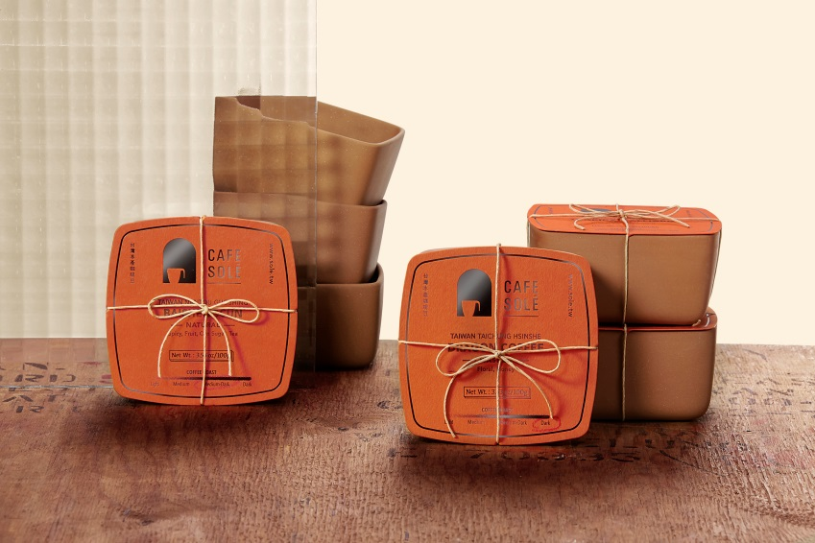
2017臺灣文博會文創精品獎
日出印象咖啡有限公司 Cafe Sole Coffee Company 攤位編號：松山S5-033
作品照片 | 作品名稱(中)：紅磚碗台灣咖啡豆 作品名稱(英)：Red Brick Taiwan Coffee
 | 作品介紹： 家，是紅磚一塊一塊堆砌的三合院， 用碎裂的紅瓦片充當蠟筆在地上作畫， 將台灣本產咖啡豆烘焙成金黃色澤， 飄散出一陣一陣濃濃花果香氣， 用對鄉土的印象燒製成紅磚碗盛裝著。 Home is a piece of traditional courtyard house that built with red brick in piece by piece. In the atrium, we use the cracked tiles as a crayon to draw on the ground and play the hopscotch games with our neighbors and playmates. It is the start of our childhood memories about home. The Taiwanese-made roaster selects the Taiwan’s coffee beans and roasts into golden color to drift out a burst of thick floral aroma. The floral aroma is then contained in the red brick bowl with the memory and impression of home in Taiwan.
文創精品獎Cultural & Creative Award

Slide 35
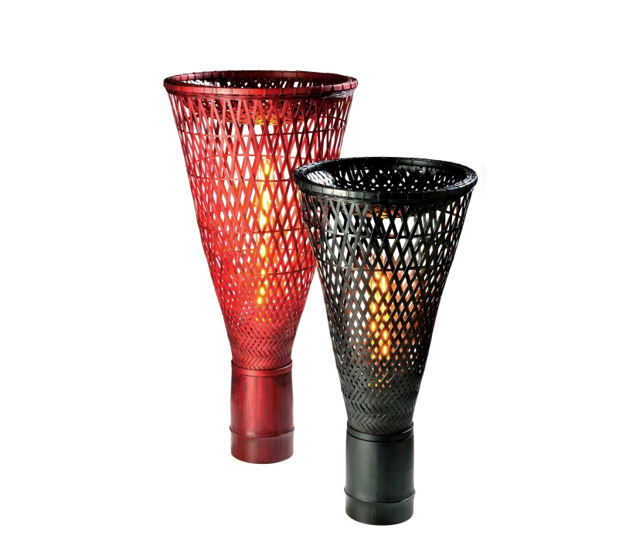
2017臺灣文博會文創精品獎
格子設計有限公司 gridesign studio 攤位編號：松山S7-007
作品照片 | 作品名稱(中)：簍燈 作品名稱(英)：LOU Lamp
 | 作品介紹： ”簍”燈( LOU Lamp)，是從臺灣先民的生活智慧；早年日常生活中普遍看到的”簍器”所獲得的靈感，透過竹管結構作工與竹編工藝技巧，巧妙的將燈飾與置物盤相結合。 “Lou Lamp”. It is not only visually beautiful but also having value added with multi-functions , and there is one tray on top of it. The concept of “Lou Lamp” came from basket. Though bamboo tube and bamboo weaving skill from craftsman, the “Lou Lamp” delivers not only the concept of bamboo basket to perform various display styles under multi kinds of the living environment, but also the strength of bamboo and light from the bamboo interval.
文創精品獎Cultural & Creative Award

Slide 36
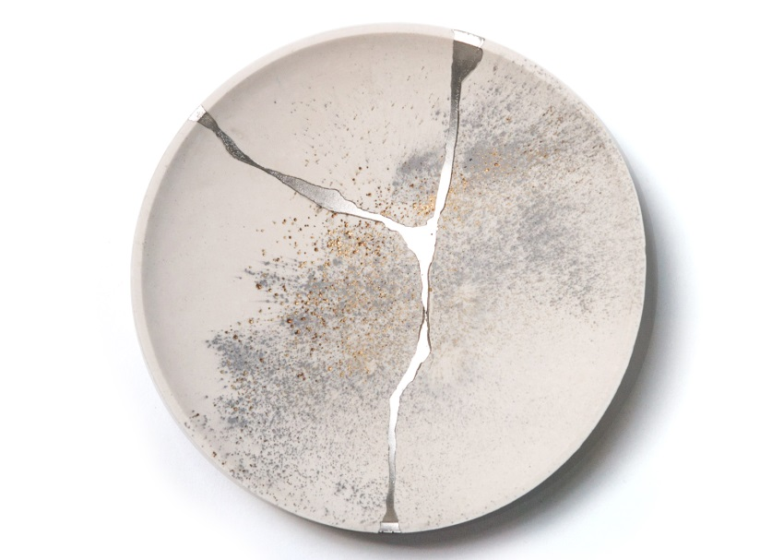
2017臺灣文博會文創精品獎
晏誠設計有限公司 YenChen Design Studio 攤位編號：華山H1-18
作品照片 | 作品名稱(中)：珠寶飾盤 作品名稱(英)：Jewellery tray
 | 作品介紹： 受陶瓷修復工藝金繕啟發，將破裂的器皿與錫合金重新熔接結合，製作含蓄、優雅並適合襯托珍貴珠寶的飾品盤。其精神源自於將物件的破損視為特色宣揚,⽽非缺陷般的藏匿起來。 The form is inspired by a philosophy from the Japanese art of pottery repairing – “Kintsugi”. Kintsugi treats breakage and repair as part of the history of an object, rather than something to disguise. We created a new casting method inspired by this ancient technique to repair cracked Jesmonite with tin and bismuth alloy. As a result, the product presents a beautiful and elegant platform to compliment precious jewelleries.
文創精品獎Cultural & Creative Award

Slide 37
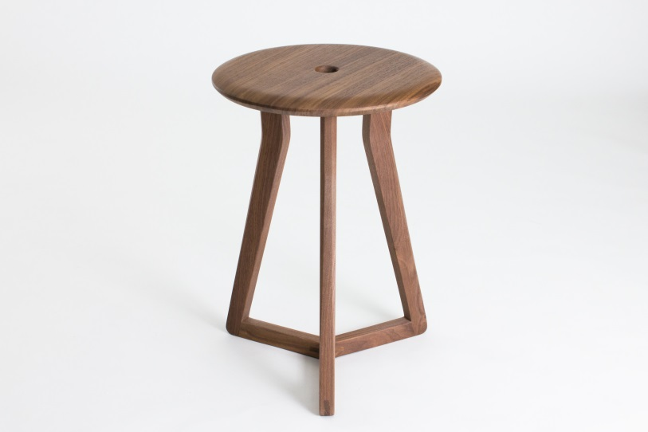
2017臺灣文博會文創精品獎
壹一木設計有限公司 YIH wood studio 攤位編號：松山S1-010
作品照片 | 作品名稱(中)：框凳 作品名稱(英)：Frame Bench
 | 作品介紹： 凳子的三腳彷彿組成三個框框，從不同角度呈現不同的幾何變化。 The three legs of bench seems form three frames, present different view from diffenrent angle.
文創精品獎Cultural & Creative Award

